Slide 1

CSC478 – Slotted aloha project
Martin boerwinkle
Yangling hu
Scott king

Slide 2






Programming solution
Software Application
MS Excel
File Sharing
GitHub
Google Docs
Add-ins and Imports
random
pyplot
References
Python Crash Course – Eric Matthes

Slide 3
Step 1 simulate Transmit with varying node counts and measure throughput
STATUS
Coding Complete
STATUS
Graph Complete
STATUS
Documentation in Progress

Slide 4
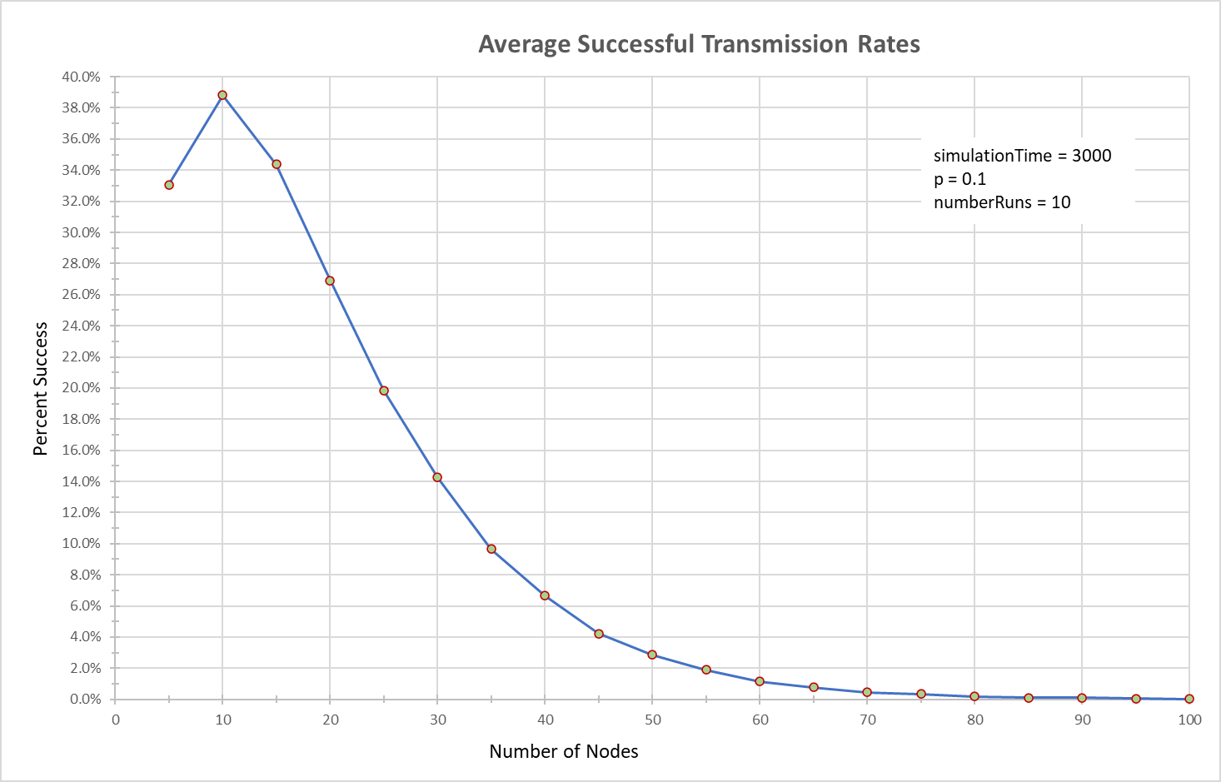
Step 1 results
Results are average of 10 runs for each node count
Transmission rate degradation as the number of nodes increases
At 10 nodes, success rate is very close to theoretical max performance of slotted aloha
Setting p = 1/n yields highest success rates

Slide 5
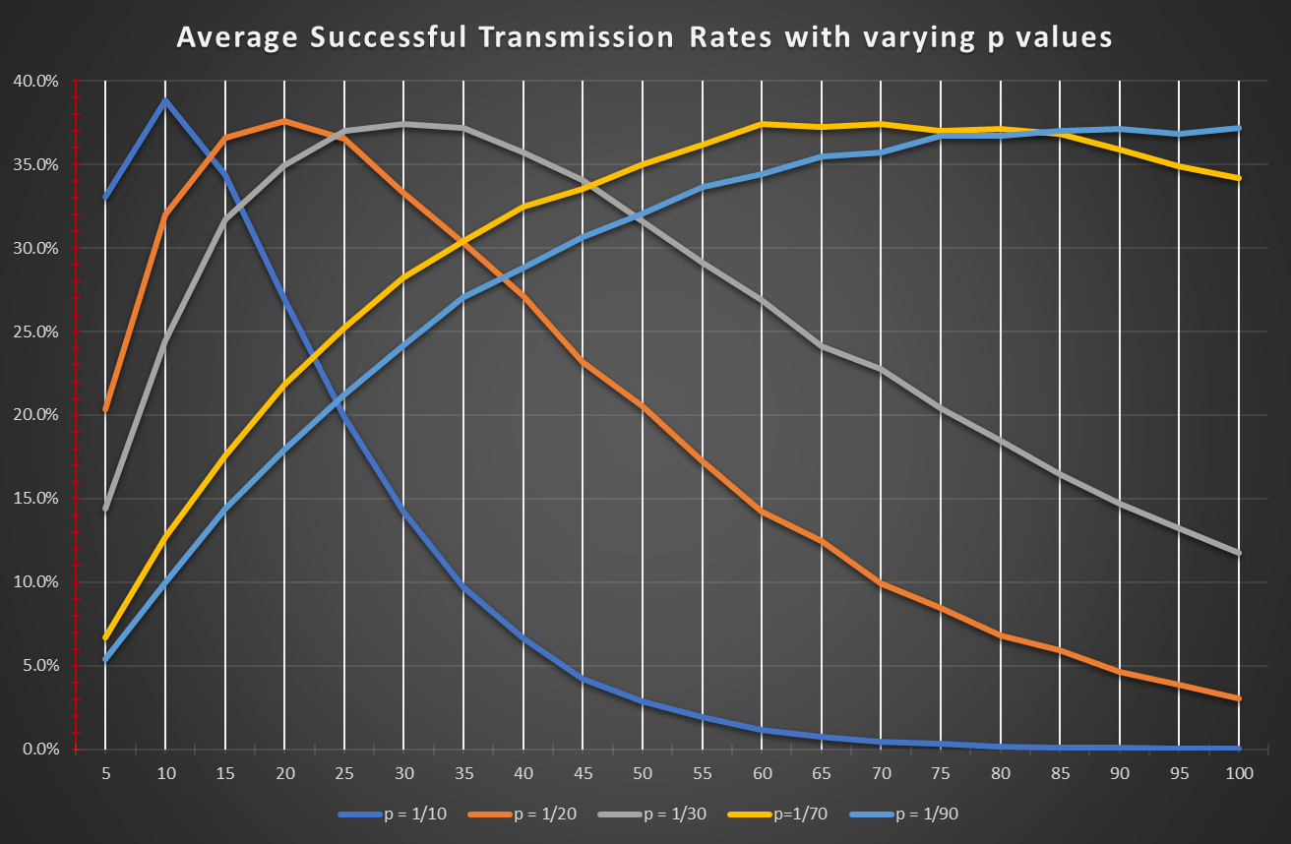
P- value vs. number of nodes relationship

Slide 6
Step 2 simulate packet arrivals and transmissions
Status:
Completed code
Sample graphs generated
Documentation not started

Slide 7
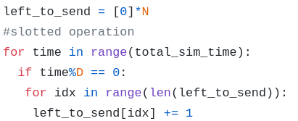
Step 2 Code
left_to_send records the number of remaining outgoing packets per node

Slide 8
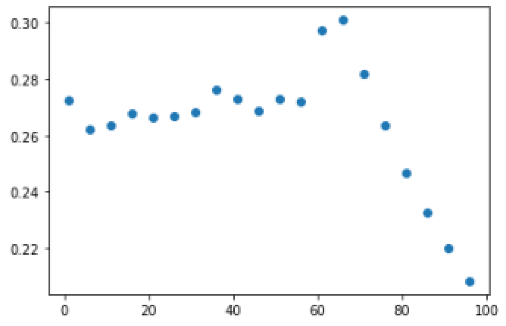
Step 2 output
For D=50, N=20 , p=0.1

Slide 9
Step 3 add packet dropping for delayed transmissions
Status:
Completed code
Sample graphs generated
Documentation not started

Slide 10
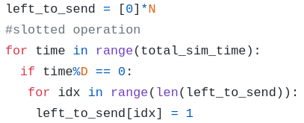
Step 3 Code
left_to_send is the same as in step 2 – but it is capped at 1

Slide 11
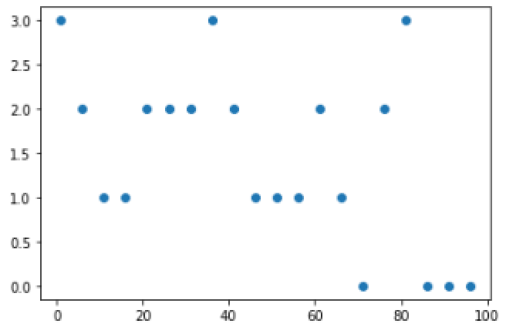
Step 3 output
The number of packets go through at D = 60 for N=20

Slide 12
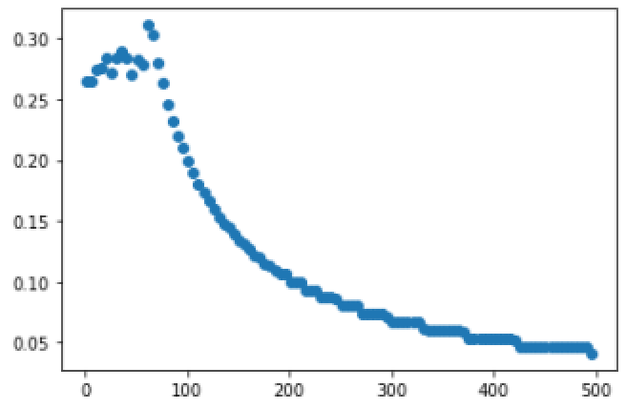
Open Question
When N = 20, p = 0.1 D = 60

Slide 13
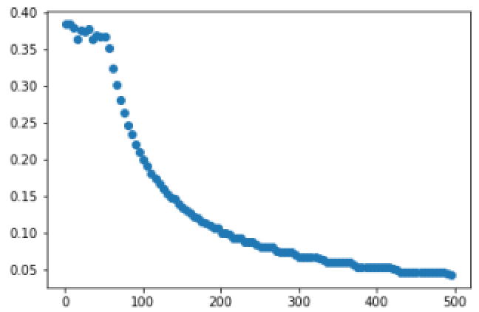
Try to decrease the p(transmission threshold)
N=20,D=60,p=0.05

Slide 14
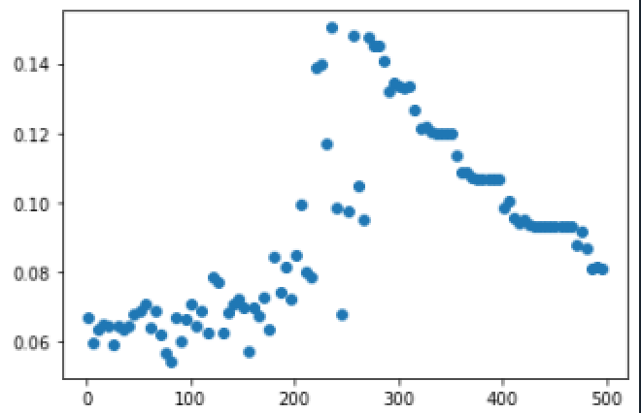
When N = 40, p = 0.1,D=60

Slide 15
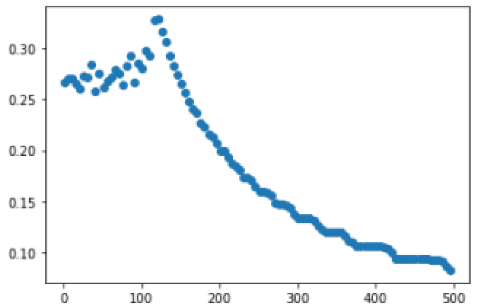
When N = 40, p = 0.05, D=60
Try to decrease the p from 0.1 to 0.05.

Slide 16
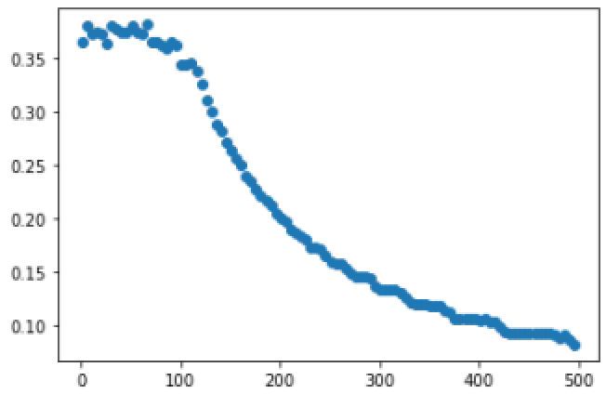
When When N = 40, p = 0.05, D=60
Try to continue decrease the p from 0.5 to 0.025

Slide 17
Ideas：
As the p decreased, the throughput will change which will achieve a high and stable throughput at the beginning of the transmission.
As the previous examples, we can easy to get the relation between p and N. For the first example p is 0.05 and N is 20, and second p for 0.025 and N for 40. The relationship is p = 1/N.

Slide 18
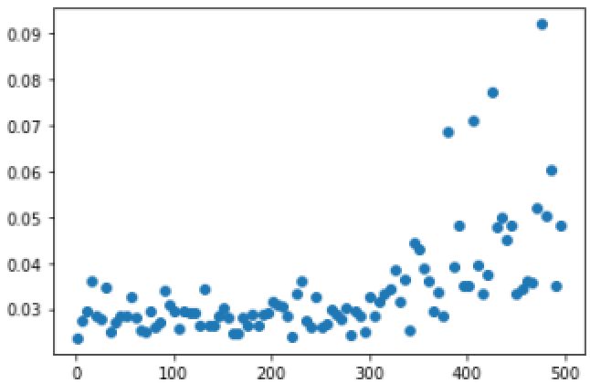
For test: N=50,D=60,p=0.1

Slide 19
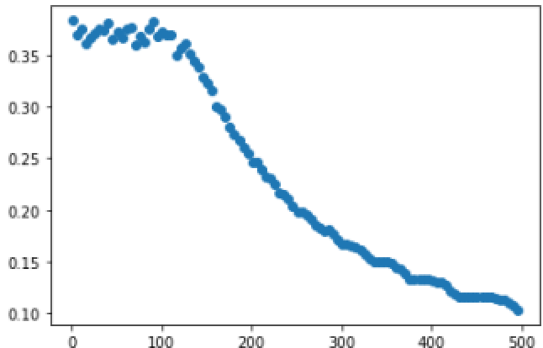
Use the p=1/N
For N=50,D=60,p=1/50=0.02

Slide 20
Questions?

